Slide 1
Azure Data Lake Storage

Slide 2
Introduction to ADLS

Slide 3
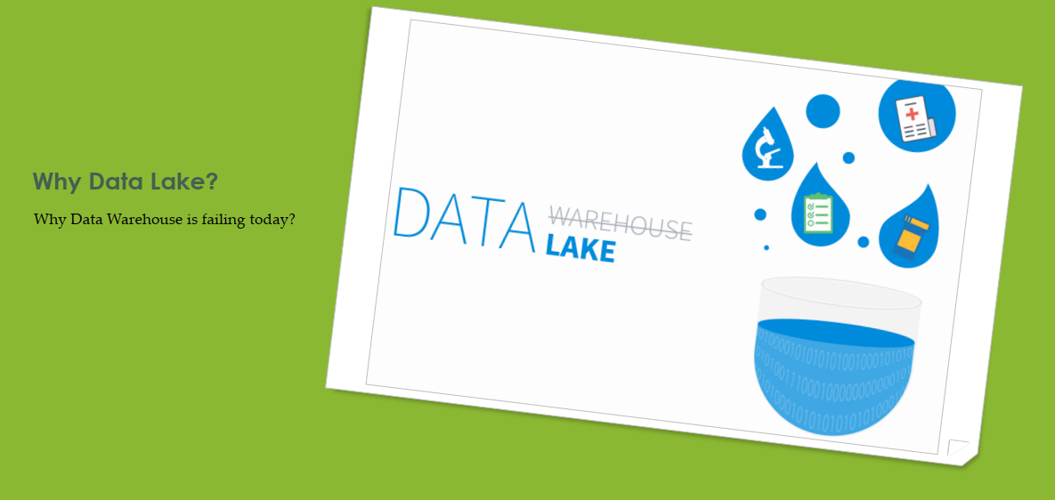
Why Data Lake?

Slide 4
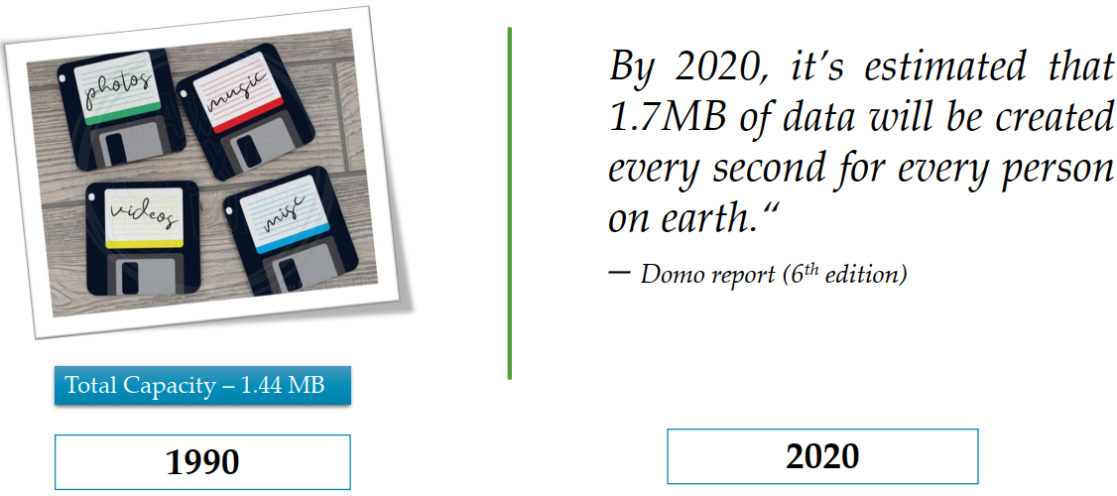
Once upon a time

Slide 5
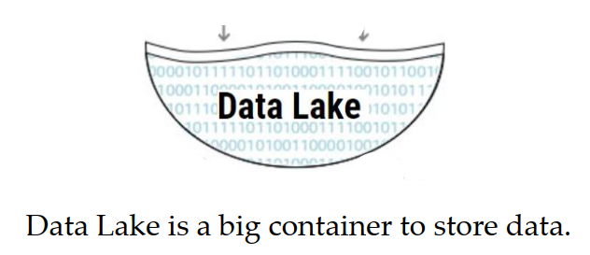
Introduction to Data Lake

Slide 6
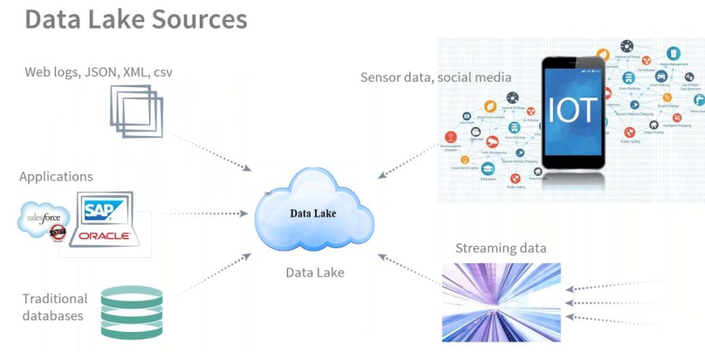
Data Lake Sources

Slide 7

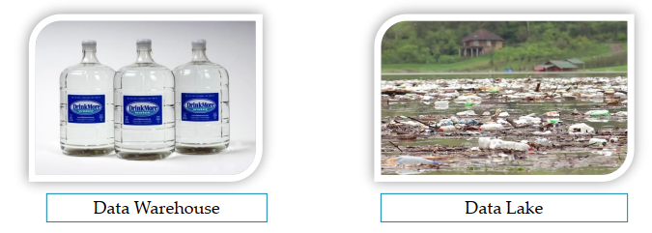
What is Data Lake?
“If you think of a DataMart as a store of bottled water – clean and packaged and structured for easy consumption – the data lake is a large body of water in a more natural state. The contents of the data lake stream in from a source to fill the lake, and various users of the lake can come to examine, dive in, or take samples.”
He coined terminology – “Data Lake”

Slide 8
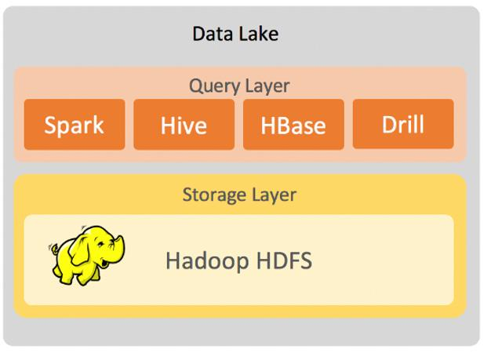
Azure Data Lake Gen1 evolution
HDFS in Cloud is nothing but Data Lake Gen1 in cloud.
Fault tolerant file system
Runs on commodity hardware
MapReduce, Pig, Hive, Spark etc.

Slide 9
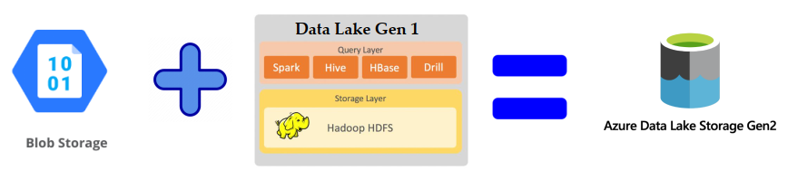
Azure Data lake Gen 2
MICRSOFT RECOMMENDS: Data Lake Storage Gen2

Slide 10
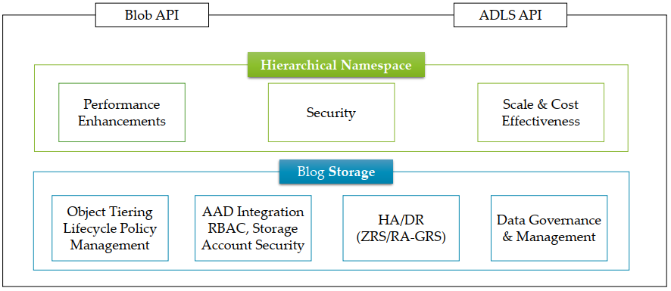
Data Lake Architecture

Slide 11
Hands-On: How to create ADLS Gen2?
How to create ADLS Gen2?

Slide 12
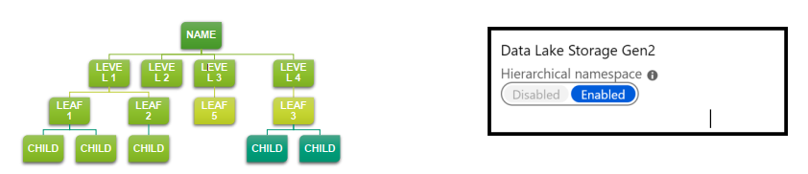
Hierarchical namespace
Hierarchical namespace organizes objects/files into a hierarchy of directories for efficient data access.
Blob storage is not hierarchical namespace
Blob can’t integrate with Hadoop

Slide 13
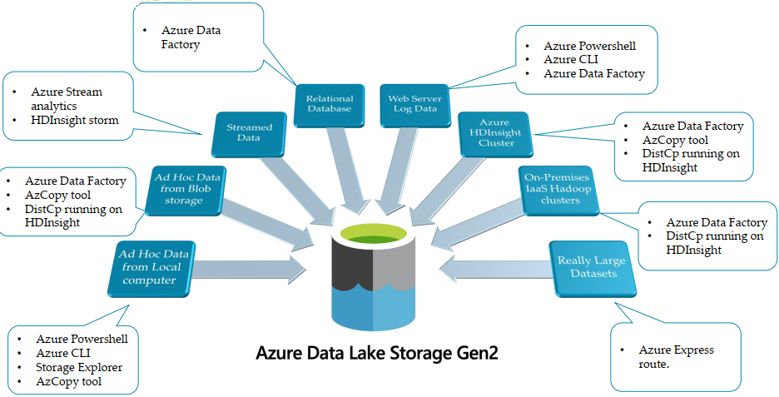
Data Ingestion

Slide 14


